Slide 1
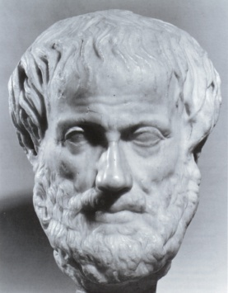
Aristotle (384 BC -322 BC)
a Greek philosopher
a student of Plato
teacher of Alexander the Great
wrote on many subjects:
physics, metaphysics, poetry, theater, music, logic, rhetoric, politics, government, ethics, biology, and zoology.
Rhetoric:
persuasive speech or writing: speech or writing that communicates its point persuasively

Slide 2
Aristotle wrote:
“Moreover, it is absurd if [one were to suppose that] it is shameful not to be able to defend oneself using the body, but not shameful [to be unable to do so] with speech, which is more proper to a human being than the use of the body.”
What does this quote mean?
Get into groups of 3, answer in 1 or two sentences.
10 Minutes
Present finding to class

Slide 3
Possible answers:
“Moreover, it is absurd if [one were to suppose that] it is shameful not to be able to defend oneself using the body, but not shameful [to be unable to do so] with speech, which is more proper to a human being than the use of the body.”
You should use your voice to defend your opinions not violence
It is unwise to think that you can defend yourself with your hands better than with your speech.
It is shameful if you believe that you should defend yourself with your hands rather than your tongue.

Slide 4
After you watch The Great Debaters answer the following question:
Do you agree with Aristotle’s view of rhetoric? (Being able to defend yourself with your voice) Why or why not?
3/4 page
About 250 words
Typed
Use one quote in your explanation
Extra Credit: Identify in your paper the 1950’s-60’s American history event, that the Wiley college debate team may have drawn more attention to.
If you choose to use the internet, the following web sites might help.
www.thegreatdebatersmovie.com
http://www.fandango.com/thegreatdebaters_110243/movieoverview
http://www.quoteland.com/

Slide 5
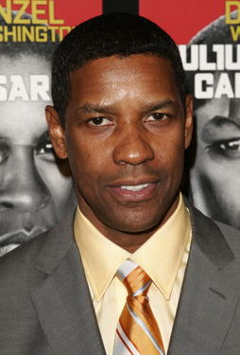
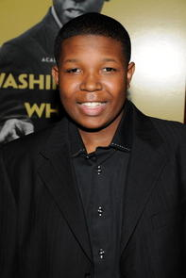
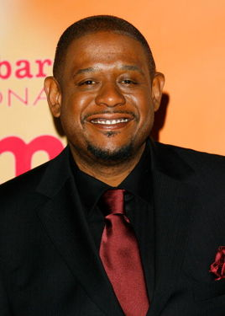
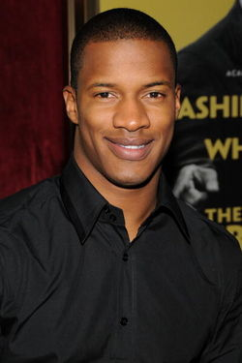
Cast
Melvin Tolson (Denzel Washington)
James Farmer Jr. (Denzel Whitaker)
James Farmer Sr. (Forest Whitaker)
Henry Lowe (Nate Parker)
Samantha Booke (Jurnee Smollett)

Slide 6
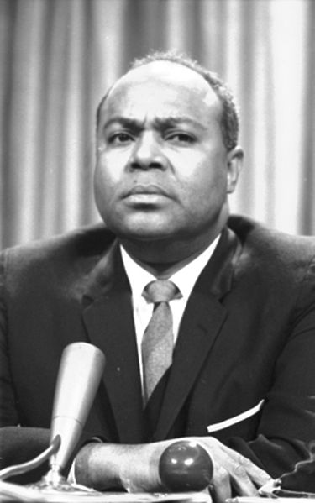
James Leonard Farmer, Jr.
(January 12, 1920 – July 9, 1999) was a Black civil rights activist who was one of the "Big Four" leaders of the American civil rights movement of the 1950s and 1960s (along with Roy Wilkins, the Rev. Dr. Martin Luther King Jr. and Whitney M. Young Jr.).
In 1942, Farmer and a group of students co-founded the Committee of Racial Equality, later known as the Congress of Racial Equality (CORE), an organization that sought to bring an end to racial segregation in America through active nonviolence. Farmer was the organization's first leader, serving as the national chairman from 1942 to 1944.

